Slide 1
Workshop 2: Exploring My Power and Privilege

Slide 2
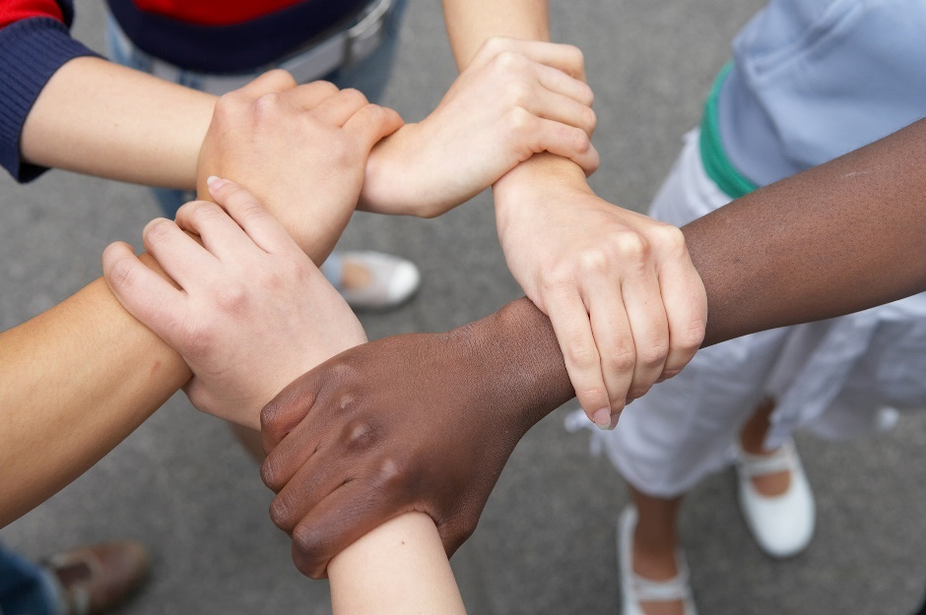
Community Commitments
Listening
Right to Pass
Appreciation
Confidentiality
Speak for Yourself
Right to “Ouch”

Slide 3
Key Points from Workshop 1
We all have diverse talents, skills and experiences.
Canada is a diverse country. This diversity brings numerous challenges and assets to society.
Diversity is a fact. Inclusion is a choice/action.
We all have complex identities, consisting of visible and invisible components.

Slide 4
Equality vs. Equity Classroom Scenarios
Scenario A: Lisa has a diagnosed learning disability. She requires more time to write tests. Some students complain that it isn’t fair that she gets more time.
Discussion with a partner:
1) Is it fair Lisa gets more time? Why or why not?

Slide 5
Equality vs. Equity Classroom Scenarios
Scenario B: Ms.K reminds students that everyone is required to show up to class on time, at 9:00am sharp. Mark lives farther away than everyone else. He asks Ms.K if he can be given an exception to the rule and be allowed to come to class at 9:15am.
Discussion with your table group:
1) Is it fair that Mark be given an exception to the rule? Why or why not?

Slide 6
Discussion
When is it appropriate to apply the same rule to everyone (Scenario B) and when is it appropriate to offer an accommodation (Scenario A)?
What would the consequences be if Lisa was treated the same as everyone else?

Slide 7
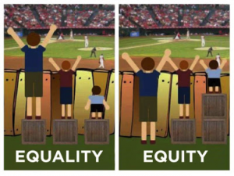
Equality vs. Equity
Source: http://everydayfeminism.com/wp-content/uploads/2014/09/Untitled1-300x225.png

Slide 8
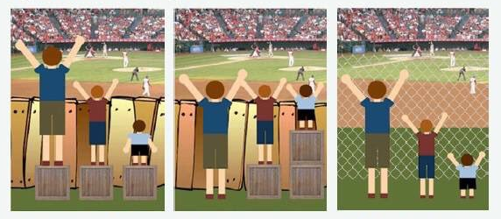
Equality vs. Equity
1
2
3
Source: https://twitter.com/cechr_uod/status/731046018633060352

Slide 9

Paper Basket Exercise
Part 1: Introduction to Privilege

Slide 10
Paper Basket Exercise
Part 2: Scenarios

Slide 11

Power Flower
Part 1: Group Power
Featured in the Access to Media Education Society’s “Racism for Reel” resource guide (2002), this activity was invented by Enid Lee and developed by members of the DorisMarshall Institute in Toronto. It is from the book Becoming an Ally: Breaking the Cycle of Oppression by Anne Bishop. (Halifax NS: Fernwood, 1994.)

Slide 12
Power Flower
Part 2: Individual Power
Featured in the Access to Media Education Society’s “Racism for Reel” resource guide (2002), this activity was invented by Enid Lee and developed by members of the DorisMarshall Institute in Toronto. It is from the book Becoming an Ally: Breaking the Cycle of Oppression by Anne Bishop. (Halifax NS: Fernwood, 1994.)

Slide 13
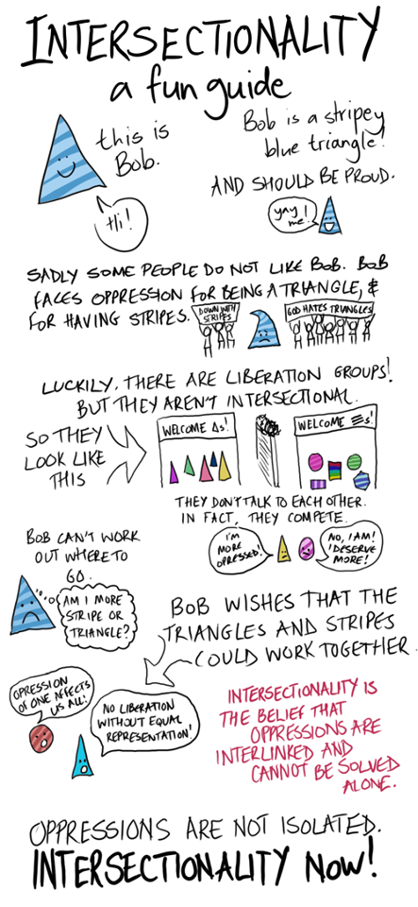
“There is no thing as a single-issue struggle because we do not live single-issue lives.”
-Audre Lorde

Slide 14









Walking the Talk:
Introduction to Social Movements
Geographic
Body Type
Sexual orientation
Gender
Race
Ability
Ethnic Group
Social class
Religion

Slide 15
Key Concepts
We need to value and recognize diversity to create equity.
We need to be aware of the contextual privileges that come with our identity and work to level the playing field.
Intersectionality ought to be considered when thinking about social change.
Social movements have emerged by those who are working towards equity.
Social media has an important role in contemporary social movements.

